Slide 1
DJANGO BOOTCAMP
30 October,2018

Slide 2
Check your Django version
To check:-
python -m django –version or py -m django –version
Current version is : 2.1.2

Slide 3
Creating a project
To start a project `mysite` type the following command:
django-admin startproject mysite

Slide 4
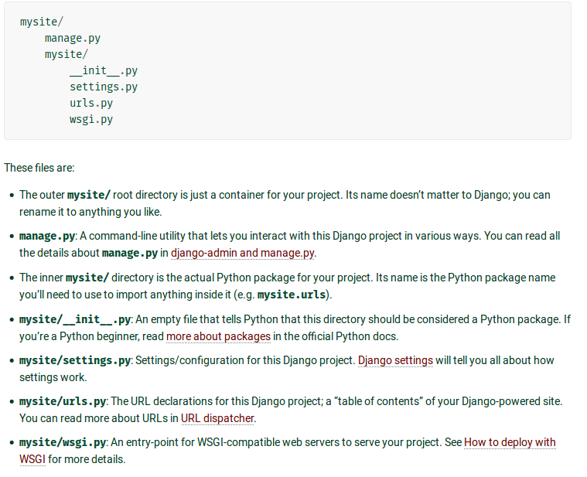

Slide 5
Verify
To check if your project mysite has been succesfully intiated :
Go inside the mysite directory by typing :- cd mysite
Run :- python manage.py runserver
Open your browser and go to 127.0.0.1:8000

Slide 6
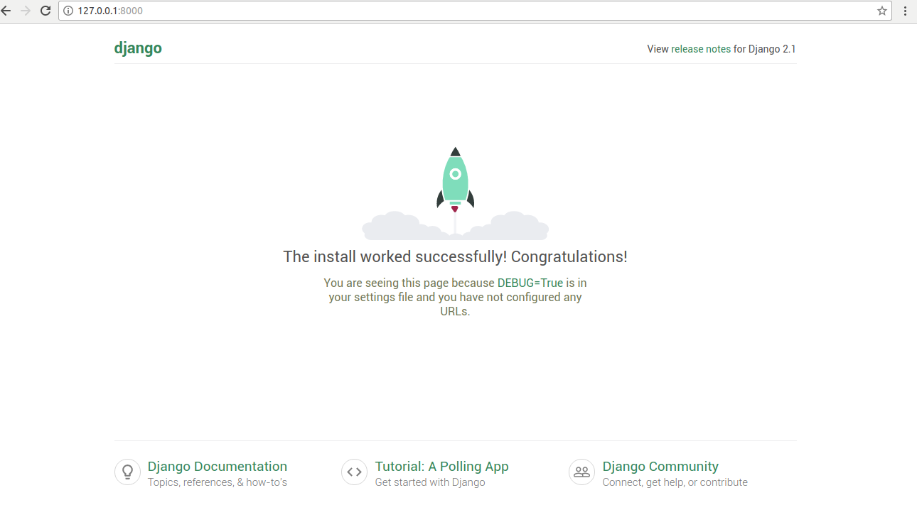

Slide 7
Creating a To Do list app
This webapp will take a task from user and display it in a list.
To create your app, make sure you’re in the same directory as manage.py and type this command:
python manage.py startapp todolist

Slide 8
MVC pattern
Models: Models represents how data is organized in the database. In other words, in MVC pattern we use models to define our database tables and the relationships between them.
Views: A view is what you see when you visit a site. For example, a blog post, a contact form etc, are all examples of views. A View contains all the information that will be eventually sent to the client i.e a web browser. Generally, views are HTML documents.
Controllers: The controller controls the flow of information. When you request a page that request is passed to the controller then it uses programmed logic to decide what information is needed to pull from the database and what information should it pass to the view. The controller is the heart of the MVC architecture because it acts as a glue between models and views.

Slide 9
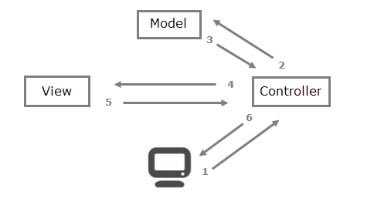

Slide 10
MVT
Django follows MVC pattern very closely but it uses slightly different terminology. Django is essentially an MTV (Model-Template-View) framework. Django uses the term Templates for Views and Views for Controller. In other words, in Django views are called templates and controllers are called views. Hence our HTML code will be in templates and Python code will be in views and models.
Therfore views.py is a controller.

Slide 11
Views.py
Views in Django works as a controller.
Go to the the sample code folder and find views.py file.
Copy its contents to views.py file of our project folder.

Slide 12
Urls.py
Let's see what happens when you request a page.
When you request a page the first thing Django does is to remove the host portion of the URL, for example, in the URL http://127.0.0.1:8000/todolist/main_page the host portion is 127.0.0.1.
Then, Django reads the value of variable ROOT_URLCONF from Django project's settings.py file. So what's the role of ROOT_URLCONF?
The ROOT_URLCONF contains the URLconf which must be loaded first. It is also known as root URLconf or site-wide URLconf. In our case it points to urls.py located in mysite/mysite directory.

Slide 13
Urls.py
After reading ROOT_URLCONF, Django checks each URL pattern one by one in the root URLconf with the requested URL until a match is found. If a pattern is not found, a 404 error is returned.
On the other hand, If a pattern is found then Django calls the associated view function. If the second parameter to the url() function includes a call to include() function then Django chops off whatever the part of the URL matches up to that point and sends the remaining part of the URL to the included URLconf for further processing.
Here is an example:
Let's say the requested URL is http://127.0.0.1:8000/todolist/main_page the first thing Django does is to remove the host portion of the URL. After stripping host portion http://127.0.0.1:8000/todolist/main_page becomes /todolist/main_page/. The string /todolist/main_page/ is then checked against each URL pattern one by one, until a match is found.Since the include() function is present, Django detects 'todolist' in /todolist/main_page/ and chops it and sends the remaining string /main_page/ to todolist.urls for further processing.

Slide 14
Database setup
Now, open up mysite/settings.py. It’s a normal Python module with module-level variables representing Django settings.
By default, the configuration uses SQLite. If you’re new to databases, or you’re just interested in trying Django, this is the easiest choice. SQLite is included in Python, so you won’t need to install anything else to support your database.
In settings.py , under INSTALLED APPS check if your app is present or not.
If not present then add it.
To create Database tables for all INSTALLED APPS run this command:
python manage.py migrate

Slide 15
Models.py
Models in Django are databases were information is stored.
Go to the the sample code folder and find models.py file.
Copy its contents to models.py file of our project folder.
To learn more about models go to :-
docs.djangoproject.com/en/2.1/topics/db/models/
overiq.com/django/1.11/basics-of-models-in-django/
To activate the created model run following commands:-
1.python manage.py makemigrations todolist
2. python manage.py migrate
For Django orm basics- https://overiq.com/django/1.11/django-orm-basics-part-1/

Slide 16
Templates
Go to-
https://overiq.com/django/1.11/basics-of-django-templates/
For template filters –
https://overiq.com/django/1.11/template-filters-in-django/

Slide 17
Get request
The GET Method
GET is used to request data from a specified resource.
GET is one of the most common HTTP methods.
Note that the query string (name/value pairs) is sent in the URL of a GET request:
/test/demo_form.php?name1=value1&name2=value2
Some other notes on GET requests:
GET requests can be cached
GET requests remain in the browser history
GET requests can be bookmarked
GET requests should never be used when dealing with sensitive data
GET requests have length restrictions
GET requests is only used to request data (not modify)

Slide 18
Post request
POST is used to send data to a server to create/update a resource.
The data sent to the server with POST is stored in the request body of the HTTP request:
POST /test/demo_form.php HTTP/1.1 Host: w3schools.com name1=value1&name2=value2
POST is one of the most common HTTP methods.
Some other notes on POST requests:
POST requests are never cached
POST requests do not remain in the browser history
POST requests cannot be bookmarked
POST requests have no restrictions on data length

